Slide 1
RGBDigit CLock
Presentator:
Asadullah Chaudhry

Slide 2
Content
1
Introduction
Material and methods
Software
Price list
Results
Demo
Discussion

Slide 3
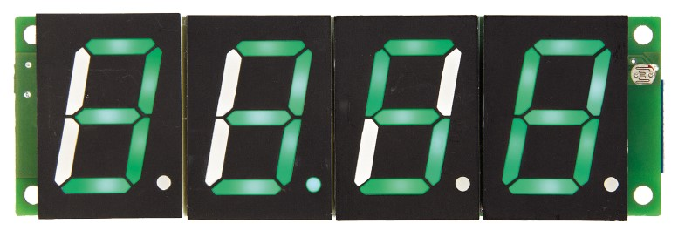
Introduction
2
Which device did I build?
What does it do?
What are its main characterisctics?
What is the reason you build this?
Notes:
I build a RGB digit clock as you can see on the picture, the picture shows an example of the clock, This picture is from elector magazine.
This project RGB Digit Clock which means the clock can change into many colours. It also can show the temperature from the room and air pressure .
The reason I choose this project because I didn’t like the other project much and I wanted build something with rgb or led lights.

Slide 4
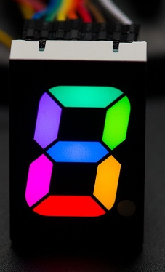
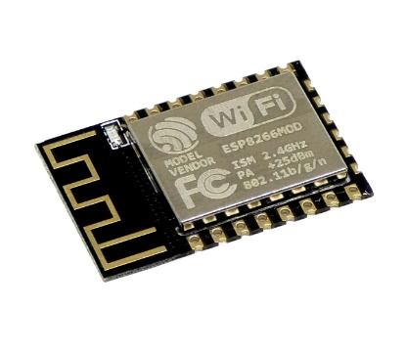

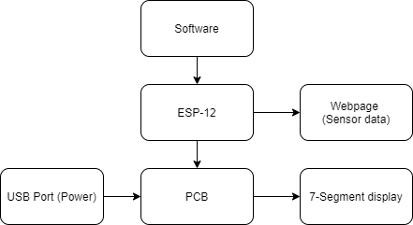
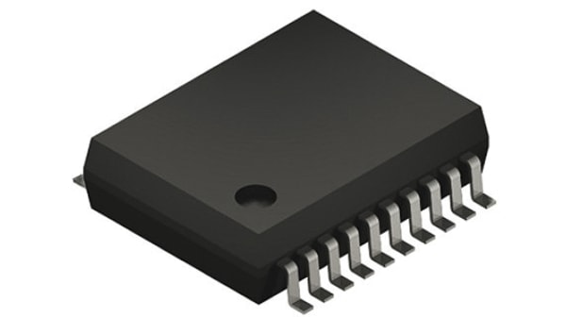
Material and methods
3
ESP-12f
IC’s
Multi-colour 7-segment
256 x 256 x 256 = 16.777.216
Arduino
Flowchart
Notes:
The clock is controlled by a ESP12 module, so it can be synchronized with a time server on internet, controlled with a mobile device or computer from the wifi.

Slide 5
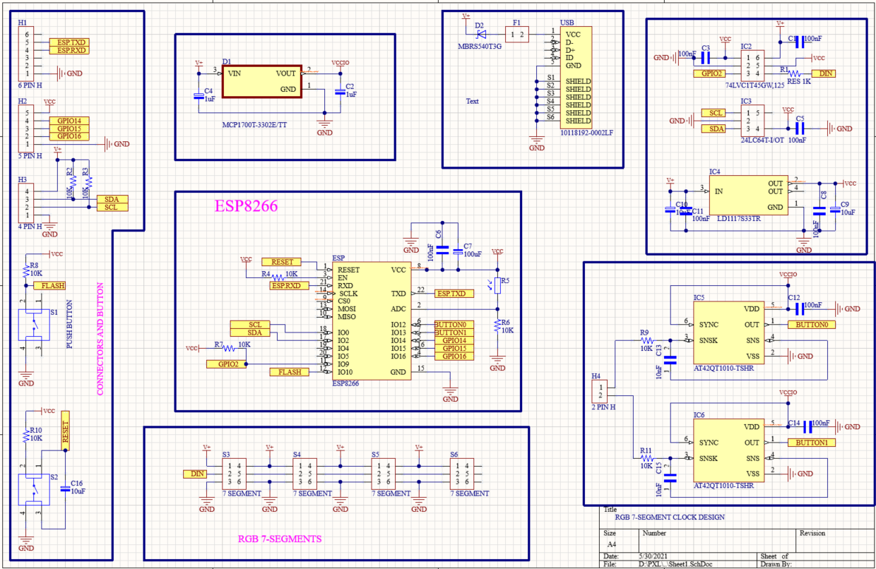
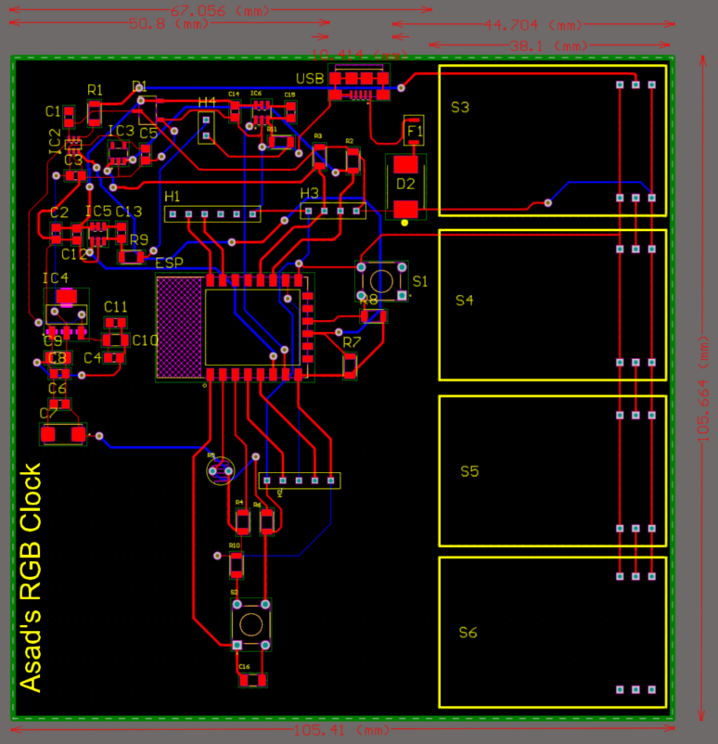
Software
4
Altium
Schematic
PCB design
Notes:
In this scheme all components are placed in several blocks. There are 7 categories, It is to make easier for me and for the teacher. There are also all then components that I used in my project. Most of the components are drawn by my self so it took a while to complete it.
The hardest part was to make pcb design, because the components are really small so that needed a lot of attention, and it had a lot of errors in the beginning, so it took a while to fix the erorrs.
On the left side you can see the measurements of the pcb that is for the autocad 3d design to make the case, that I’ll talk in a bit.
You can also see that it’s different from the clock I showed you at the beginning, that’s because I wanted to make something different and not just copy paste.

Slide 6
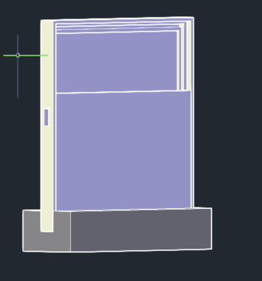
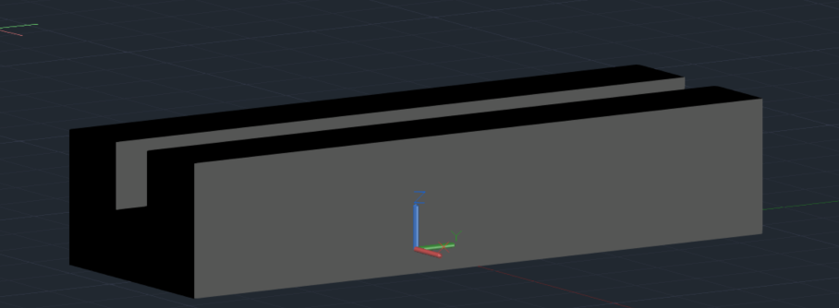

Software
5
Autocad
Main case
Slide
Foot
logo
Notes:
The other software I used is autocad for the 3d case for my pcb it wasn’t that hard because I had the measurements from the pcb.
I made my case in 3 different pieces. The slide so i don’t have to screw the case. The Foot so it can stand because it isn’t thick. And the main case for my pcb as you can see there is also openning in the front for the rgb 7-segment.
And there is also my logo that also was made in autocad but in 2d.

Slide 7
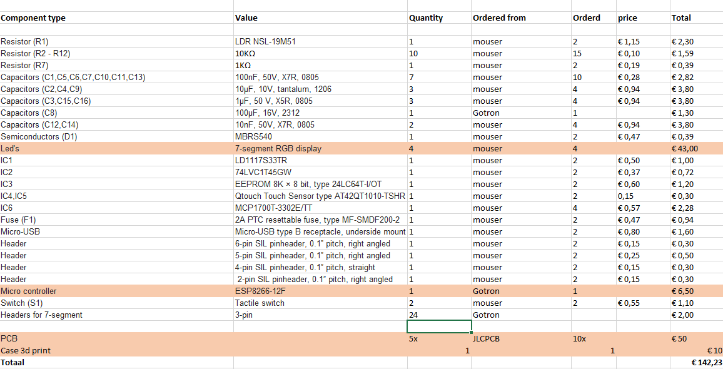
Price List
6
€142

Slide 8
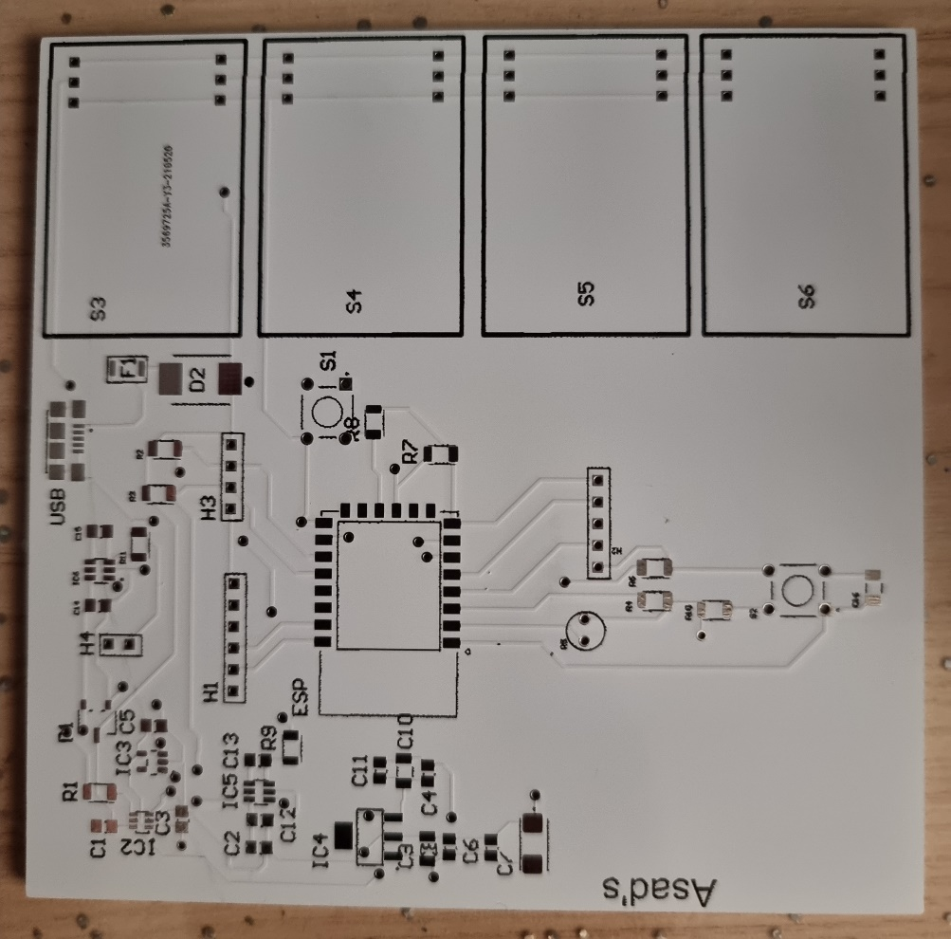
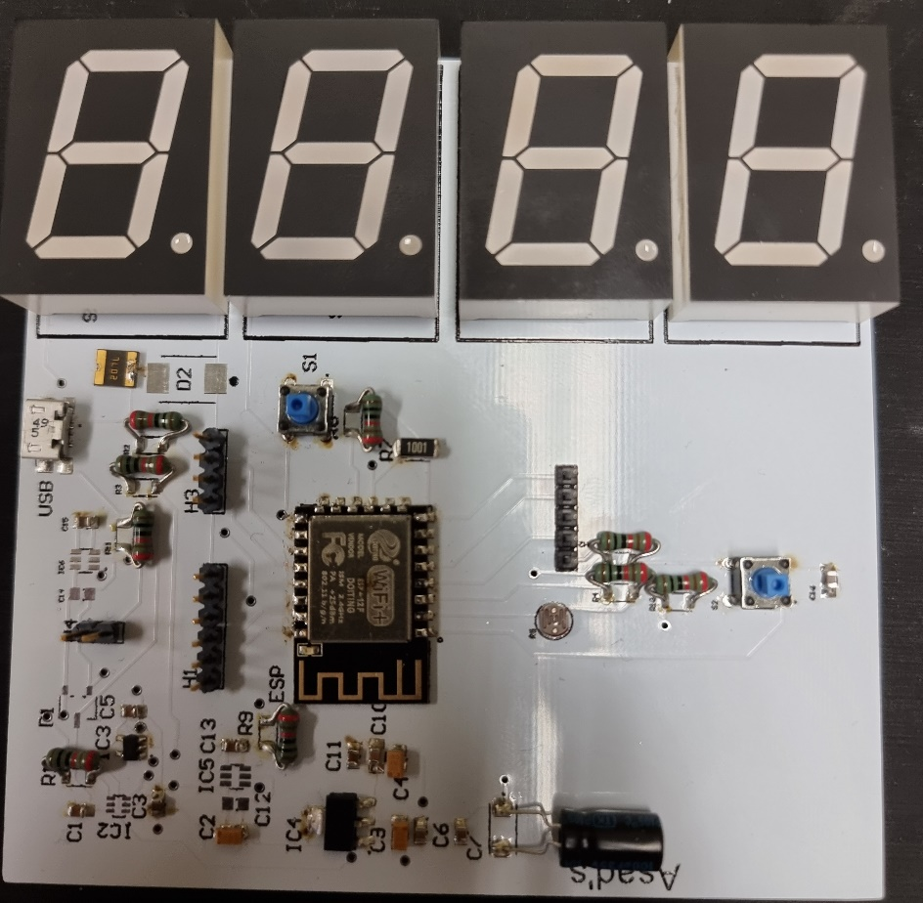
Results
7
PCB
Components
5 working days
JLCPCB
€ 24 x2

Slide 9
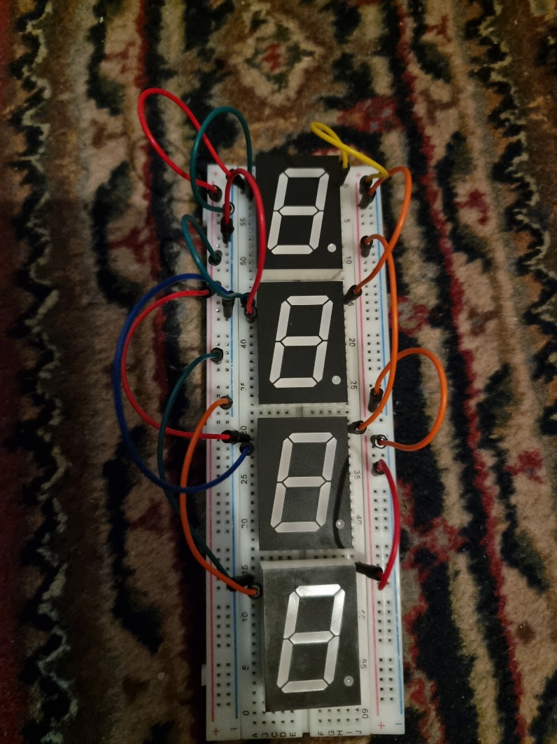
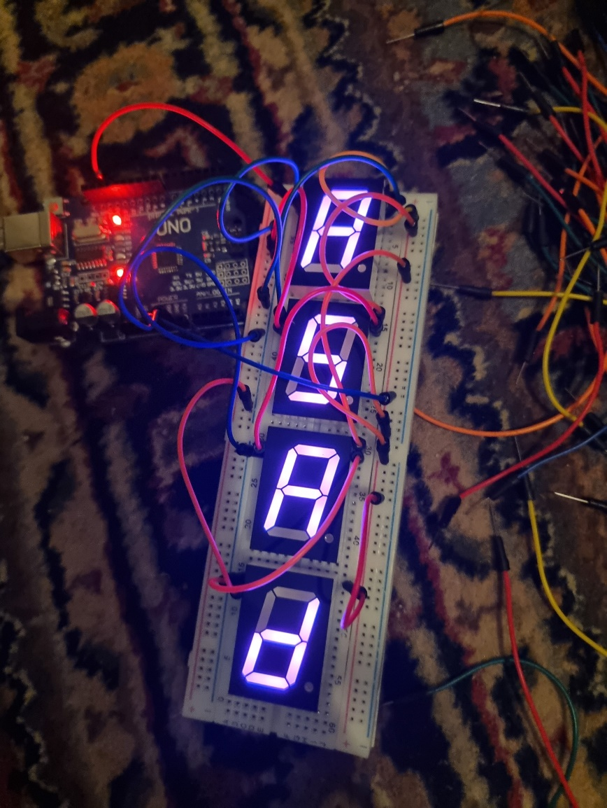
Demo
8
Prototype

Slide 10
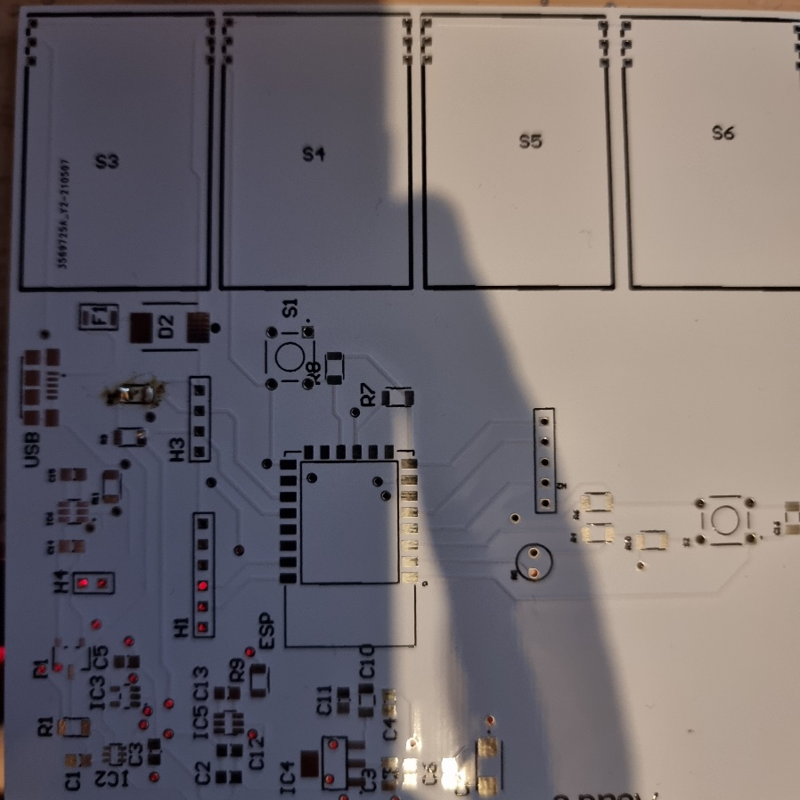
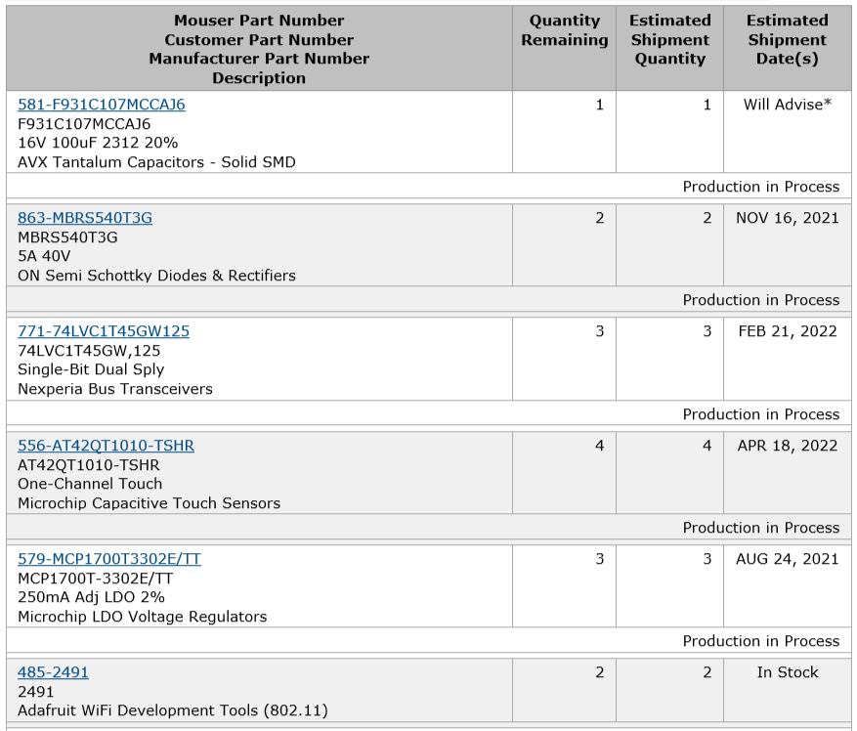
Discussion
9
Wrong PCB
Still in transit
Expensive
Notes:
One of the big problems was the shipments toke too long and some of them are still in transit.
Second problem is it’s too expensive so don’t just take a random project, choose a project you can afford.
Third problem was the most of classes were online so you have to mail the teachers first and wait till they replay.

Slide 11
10
Any Questions?

